Slide 1
Hotel Reservation Analysis
BY RAHUL S

Slide 2
Overview:
The hotel industry relies on data to make informed decisions and provide a better guest experience.
Here we will work with a hotel reservation dataset to gain insights into guest preferences, booking trends, and other key factors that impact the hotel's operations.

Slide 3
Dataset Details:
Booking_ID: A unique identifier for each hotel reservation.
no_of_adults: The number of adults in the reservation.
no_of_children: The number of children in the reservation.
no_of_weekend_nights: The number of nights in the reservation that fall on weekends.
no_of_week_nights: The number of nights in the reservation that fall on weekdays.
type_of_meal_plan: The meal plan chosen by the guests.

Slide 4
Dataset Details:
room_type_reserved: The type of room reserved by the guests.
lead_time: The number of days between booking and arrival.
arrival_date: The date of arrival.
market_segment_type: The market segment to which the reservation belongs.
avg_price_per_room: The average price per room in the reservation.
booking_status: The status of the booking.

Slide 5
Data Cleaning and Processing:
Identifying and addressing any missing values, outliers and any inconsistencies.
Collecting historical data and utilizing it for analyzing patterns, trends and demands.

Slide 6
Now, Let’s talk about the insights that I have got by analyzing the given data using SQL queries.

Slide 7
This data contains total 700 unique reservations of 31 years.
It also includes:
1316 adults
69 children

Slide 8
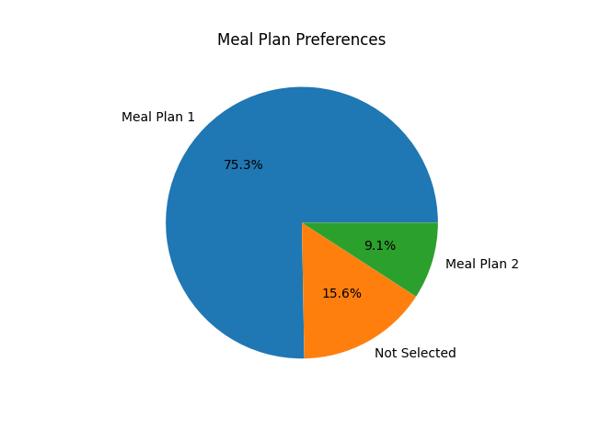
Meal Plan preferences:
From the visualization we can understand that there are 2 type of meal plans such as: Meal Plan 1 and Meal Plan 2
But as we can see here everyone have not selected a meal plan that is 109 which is 15.6% of total reservation.
Meal plan 1 has highest demand with 527 which is 75.3% of total reservation and Meal plan 2 has 64 which is 9.1% of the reservation.

Slide 9
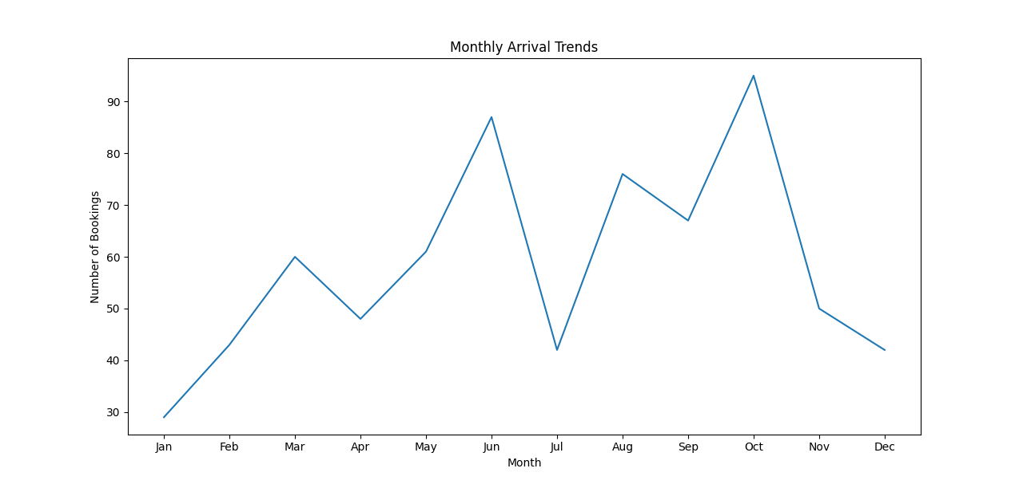
Monthly Arrival Trends:
We can see the major rise of reservations in the time of April, May, June that implies the time of Summer Vacation &
Again in September, October, November that implies Winter time.
And some major Festivals and Holidays have contributed in the rise.
But people mostly like to travel in the Winter time which lead to highest number of reservation in October.

Slide 10
Yearly Arrival :
In the 31 years of data,
2013 has highest number of reservations with 37 numbers.
2018 has 2nd highest number of reservations with 29 numbers.
2031 has least number of reservations with 9 numbers.

Slide 11
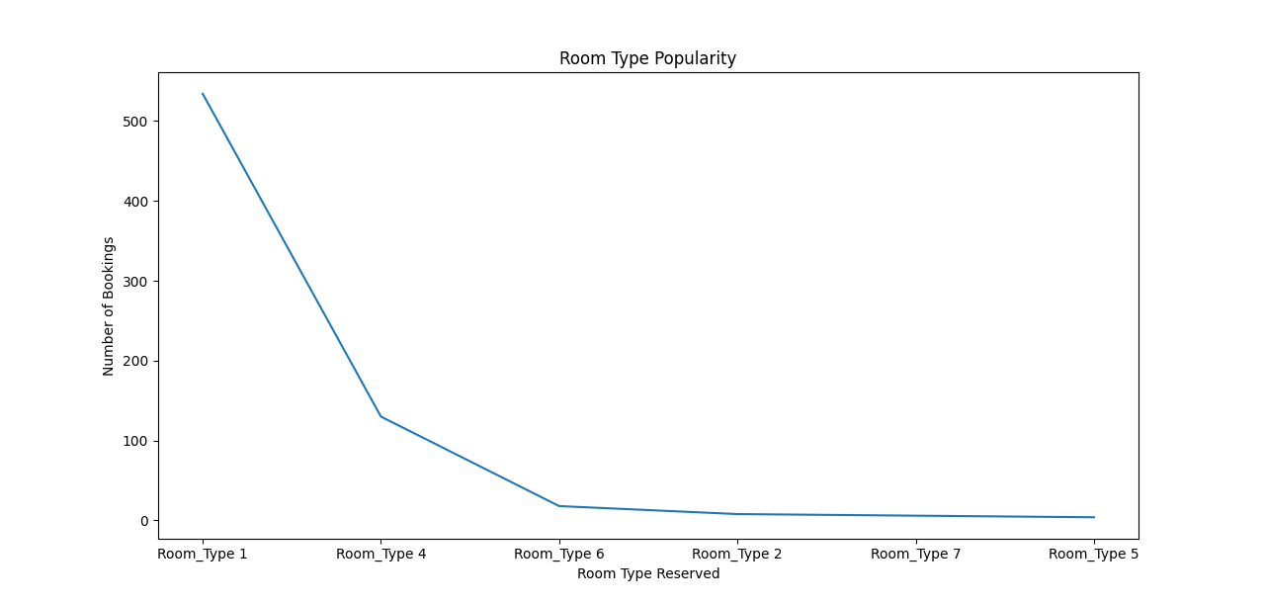
Room type popularity:
There are 6 types of rooms.
With Room_type_1 has 534 reservations having the most popularity.
Room_type_5 has 4 reservations having the least popularity.

Slide 12
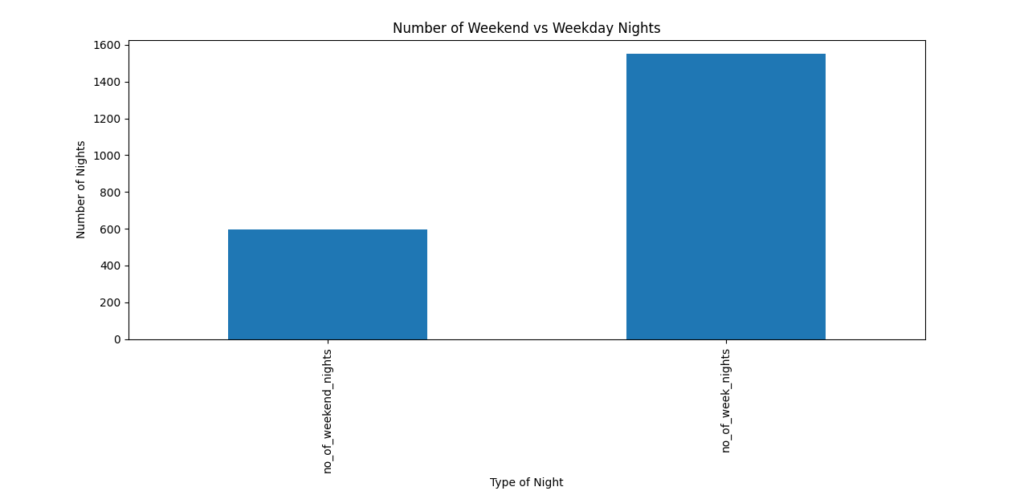
Weekend vs Weekday
This shows the reservation distribution:
Reservations_fall_on_weekend = 383
Reservations_fall_on_weekday = 656

Slide 13
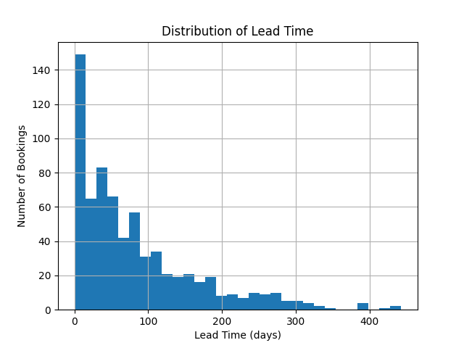
Distribution of Lead time:
From the distribution we can conclude that:
Highest leading time: 443 days
Lowest leading time: 0 days
Highest Number of reservations which have lowest leading time signifies people came to hotel the same day they reserved.

Slide 14
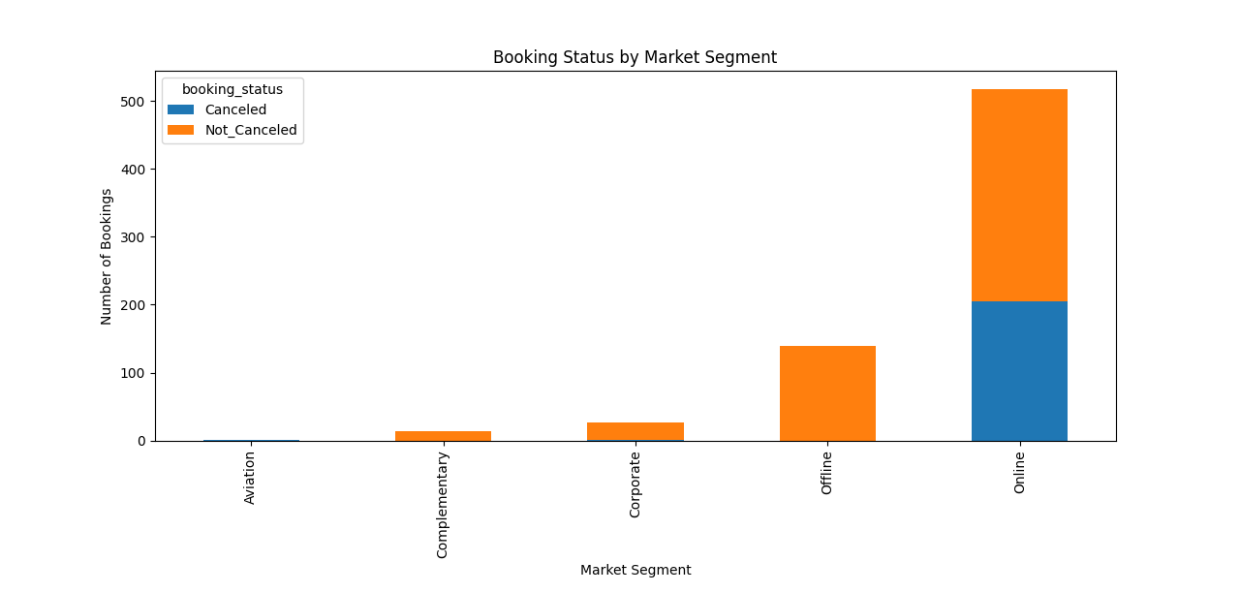
Booking Status by Market Segment:
There are 5 type of market segments:
Online having 518 (highest reservations)
Offline having 140
Corporate having 27
Complementary having 14
Aviation having 1(least reservation)
This also includes according to different segments:
Canceled reservations: 207
Not Canceled reservations: 493

Slide 15
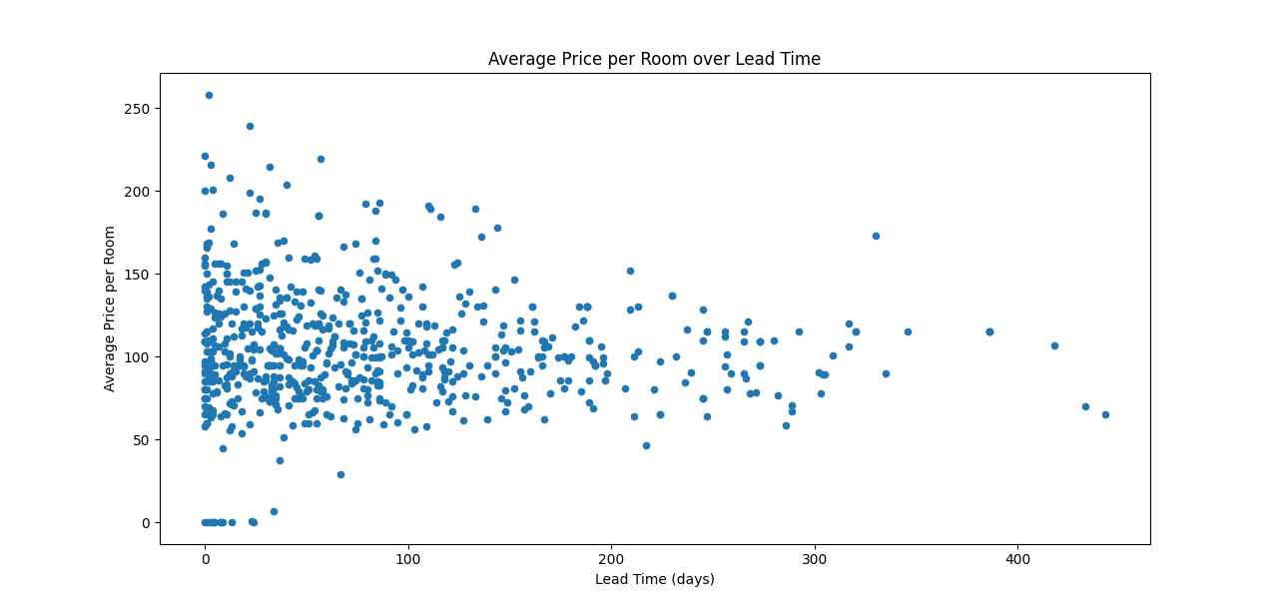
Average price per room vs Lead time:
This visualization implies the least is the leading time the high price you need to pay for the hotel room.
0 leading time or we can say people who did the reservation on the same day of arrival had paid the highest amount.

Slide 16
Some more Insights include:
Online market segment generates highest average price of 112.45 where as Complementary segment generates least average price.
Reservations involving children, Room_type_1 is the most common room type, and the average price for that room type is 123.12 with reservation number 24.
Average number of nights (both weekend and weekday) spent by guests for Room_type_4 which is the highest among all having number as 4.

Slide 17
THANK YOU

